Slide 1

Creating A Lawyer in a Box: Building User-Friendly Interviews with Docassemble
Quinten Steenhuis, Greater Boston Legal Services
@QSteenhuis / nonprofittechy.com

Slide 2

Overview
Who am I?
What I learned after a year of using Docassemble
Demo
Questions (and interrupt at any time)

Slide 3

Who am I?
Notes:
Background at CMU:
Didn’t think of CS as a career. Hobby to earn money.
Learned PHP: student senate, online elections, printing and publications, Indymedia (open publishing).
Law school:
Nobody doing tech
GBLS:
Nobody thinking about tech + law
Automated my own work but did not advertise technical skills
Crash = need new sysadmin

Slide 4
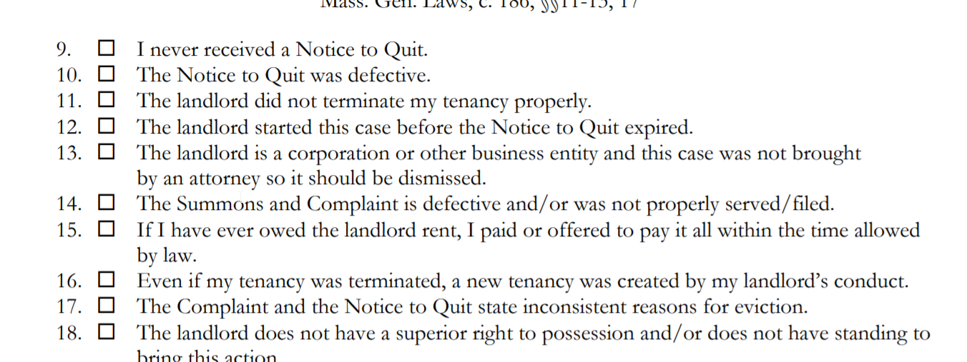
“10 Impossible Questions”
Notes:
10 years filling out this form and accompanying Discovery form
72 questions on the Answer, 90 on the Request for Discovery
Group clinic is 4 hours. One-on-one session is 1.5 hours.
Big sections that don’t apply to some tenants

Slide 5
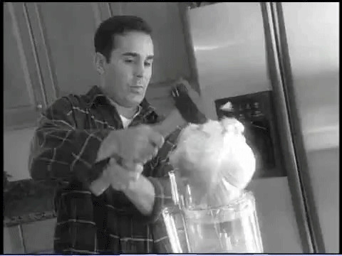
There Has to be a Better Way!
Notes:
As Billy Mays would say: There has to be a better way!
Started with HotDocs
Discovered Docassemble just as many of you did, by Googling, and amazed by how powerful it was. It’s only improved by leaps and bounds in the last year with 5 new versions a week
Spent a few hours each week since September learning and building an interview in Docassemble.
Goal was to replicate a face to face interview that I’ve done hundreds of times.
Insight that discovery could be completed automatically

Slide 6
7 Principles for Smart Guided Interviews
“Dumb” forms are not worth the work
Ask users to state facts, not conclusions
Use visuals
Do the work for the user
Get it right or don’t automate
Give help in context
Test, test, test and iterate, iterate, iterate
Notes:
If you are building a guided interview that follows a paper form exactly, you’re probably doing it wrong. It takes a lot of time just to put the form in the computer, and it won’t save the user time to type instead of write.
In a paper form: state conclusions so it can be read by the judge and opposing party. Guided Interview should stick to asking about facts as much as possible. If it takes a page of help text to answer, you’re probably asking the wrong question. Empower non-experts
Visuals: screenshots are great. Greenshot: free tool to help with making screenshots.
Do the work for the user. If you need an address, let Google look it up. If you want to know if something is filed late, do the date math. Docassemble’s ability to connect to external data is its most powerful feature!
If you do automate, you need to make sure to get it right. Guessing what the user wants is hard, and if you get it wrong it slows down the user instead of speeding things up. Make sure your interview fails gracefully.
Some users want to be educated by your interview, and some just want to get to the end. Best thing to do is to ask simple, fact-oriented questions to avoid needing explanation but you can offer more information in context.
Test: we used real-world Answer and Discovery forms to catch bugs

Slide 7

Tools and Techniques

Slide 8
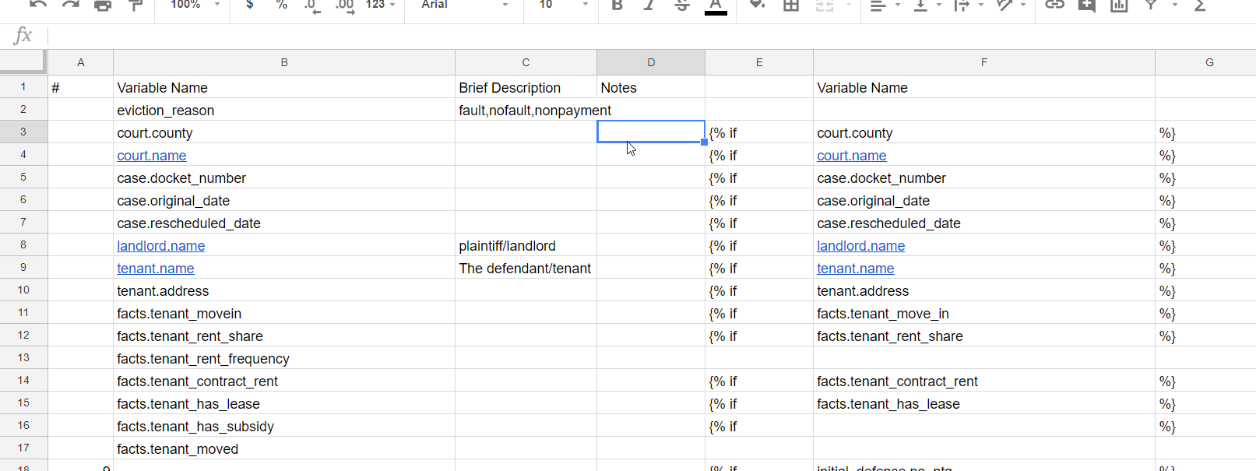
Document as you go
Google Sheets
Notes:
Needed a way to keep track of 160 variables

Slide 9
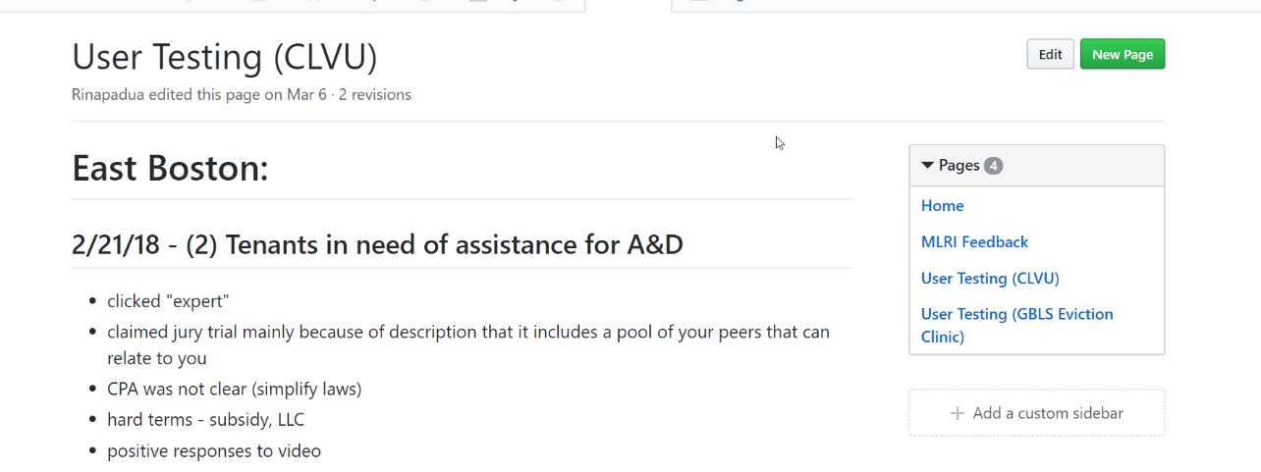
Gather User Feedback
Github Wiki
Notes:
Typed up written notes
Wiki is not perfect but easy place to store everything in one place on Github
Feedback can turn into a task but isn’t the same thing as a task

Slide 10
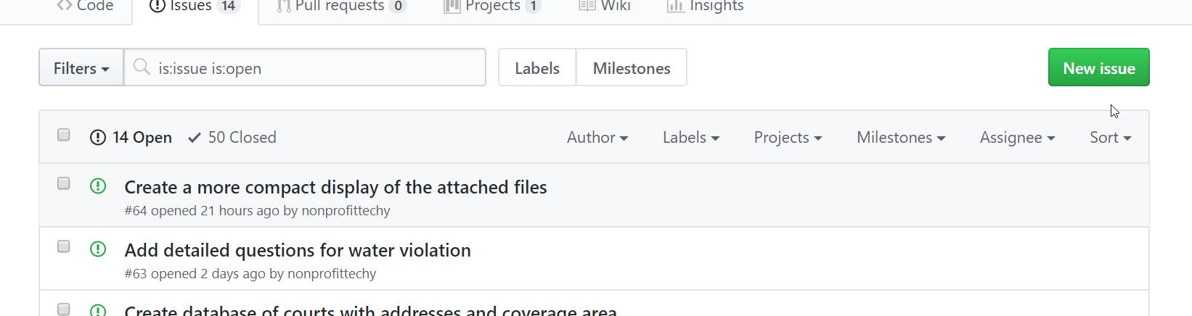
Track To-Do Items and Bugs
GitHub Issues (and Kanban)
Notes:
If you say “close” and mention issue # in commit, it will automatically close the issue

Slide 11
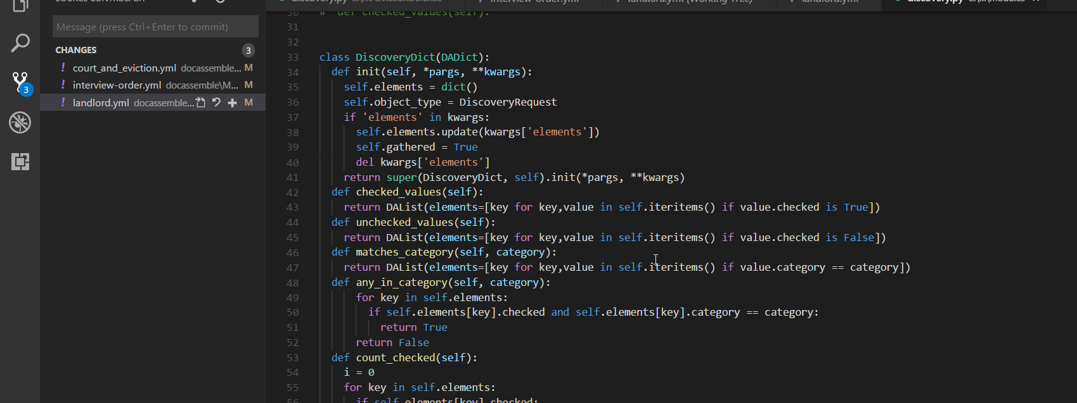
Custom Classes
VS Code
Notes:
Learned a little bit about Python OO code
Discovery class:
Extend the native DA object types
Count discovery ( we have a limit of 30)
Filter by category
Abstract logic from the template

Slide 12
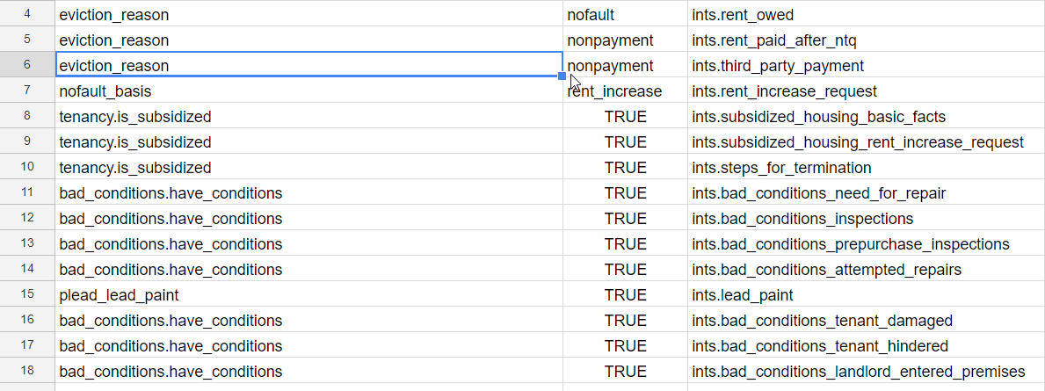
Separate Logic from Code
Quasi-DMN
Notes:
Sheet is referenced in the interview to generate dynamic question showing pre-checked discovery that depends on the user’s claims and defenses.
Why use Google Sheets to store logic?
Simple to edit
Keep track of everything in one place using a compact notation easy to understand visually
Save repetitive code typing
Meng Wong at Stanford taught me that I reinvented something called a DMN (Decision model and Notation) from business process languages
It would be interesting to see if this could be made a first-class language feature in Docassemble.

Slide 13
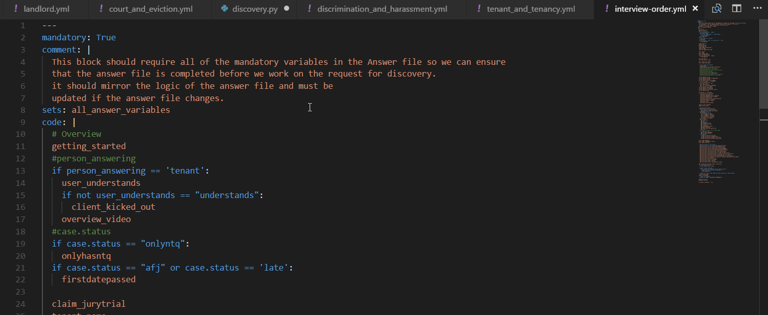
Control Question Order
Notes:
I think Docassemble could make this a first-class way of managing the interview flow.
Some people will like the natural flow, some will prefer control.
I found once we started using this testing was much easier and more predictable. Without it: tried Gherkin but it didn’t’ work.
I wanted control over a logical order of questions instead of random.

Slide 14
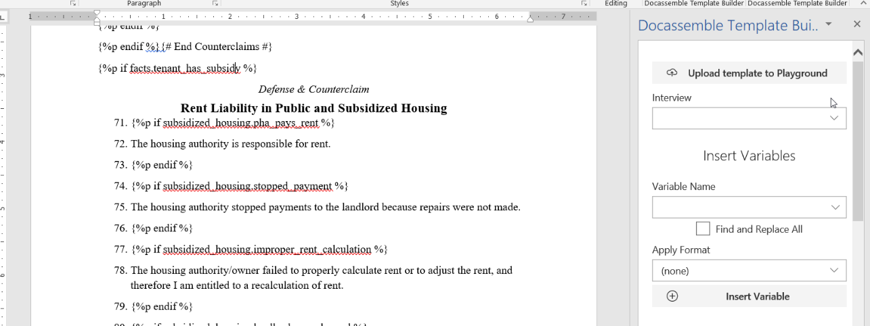
Docassemble Template Builder

Slide 15
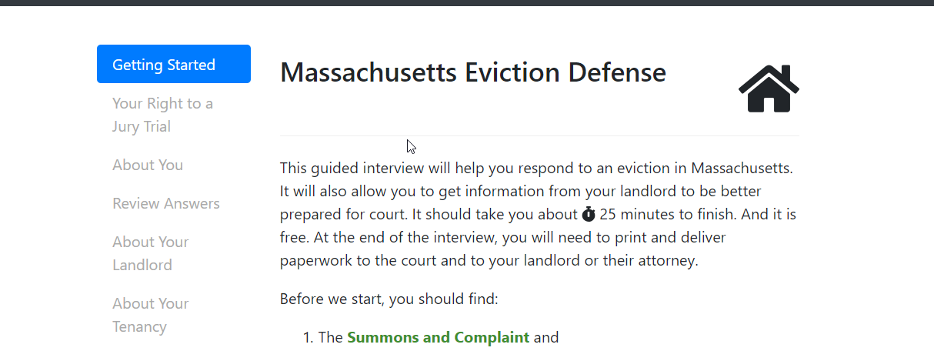
Demo
Notes:
What we learned:
Keep the intro short (fewer screens is better)
Guided/expert. Everyone thought they were an expert (SHOW: Tenant, and then switch back to Attorney)
Five possible forms, but user doesn’t need to know that.
Radios vs checkboxes
Landlord type: guess a smart default for the user
Screening questions: good and bad (save time, but users can miss things)
Retaliation: “if you are unsure, you can click yes” (still need to test this)

Slide 16
Thoughts for Docassemble
Fail earlier
Automated testing/fuzzing
Test individual questions (without logic) to just check if the display code is right
Separating legal rules from interview logic with DMN or other logic-modelling language

Slide 17

More Information
Fork us on GitHub
@Nonprofittechy @GBLSMA https://github.com/GBLSMA/docassemble-MAEvictionDefense
Docassemble Tutorial at
https://gblsma.github.io/docassemble-MotionTutorial/
or http://bit.ly/2DKyZby
Docassemble Template Builder
https://github.com/GBLS/docassemble-template-builder-addin or https://bit.ly/2t9fQwW
Nonprofittechy.com @QSteenhuis

